Slide 1


Announcing BARDA Ventures
Dr. Sandeep Patel
Director of Division of Research, Innovation and Ventures (DRIVe) at BARDA
U.S. Department of Health and Human Services
October 12, 2020

Slide 2

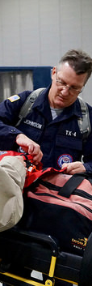
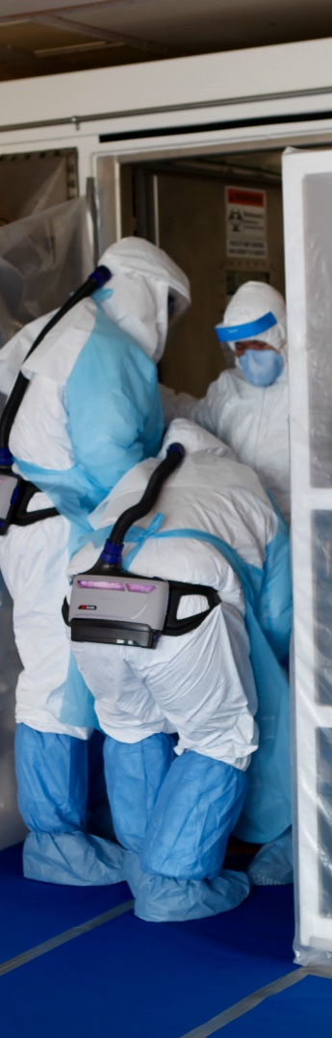
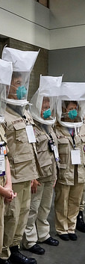

ASPR Mission
Save Lives and Protect Americans from 21st Century Health Security Threats

Slide 3

The BARDA Model
BARDA develops and makes available medical countermeasures (MCMs) by forming unique public-private partnerships to drive innovation off the bench to the patient to save lives.
Flexible, nimble authorities
Multi-year funding
Cutting edge expertise
Facilitate partnerships
Promote innovation

Slide 4




BARDA Program Divisions
Medical Countermeasures (MCM) Program
Influenza & Emerging Infectious Diseases
Chemical, biological, radiological and nuclear (CBRN) Program
Detection, Diagnostics, & Device Infrastructure
Pharmaceutical Countermeasure Infrastructure
Division of Research, Innovation, and Ventures (DRIVe)

Slide 5


DRIVe’s Approach to Innovation
We tackle big health security challenges and threats
We seek breakthrough devices and technologies
We model the best practices of the entrepreneurial world
We support new technologies, streamline contracting processes, and launch a network of accelerators
Team of scientists and venture entrepreneurs

Slide 6
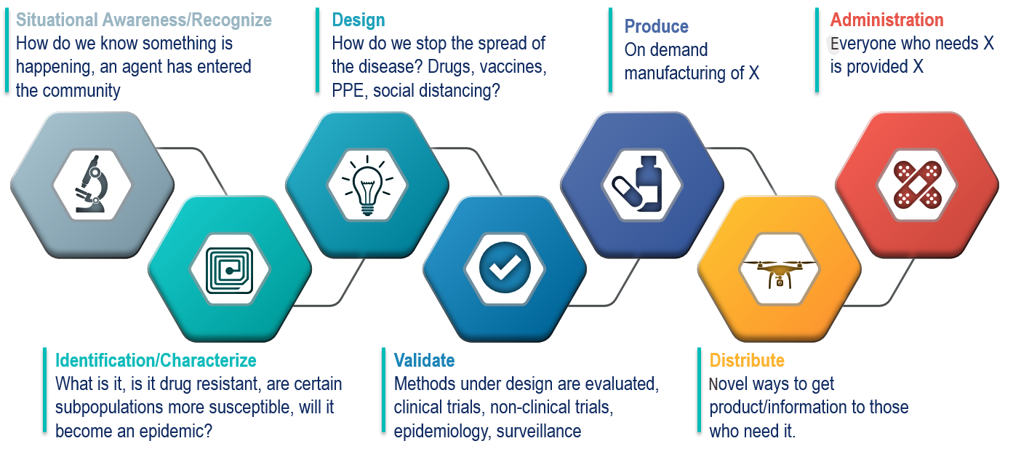
The Continuum of Response: Opportunities for Innovation

Slide 7

BARDA Ventures
Initiative to redefine how the U.S. government can partner with private sector to advance health security
21st Century Cures Act directed BARDA to enter into this partnership
Seeking to partner with an existing non-profit entity (Managing Entity) that will utilize “venture capital practices and methods to address urgent health security needs” through equity investing
Investing, developing, and harnessing technologies to improve preparedness posture against known and unknown threats

Slide 8



Why BARDA Ventures?
Enable BARDA to act with speed and flexibility to complement traditional approaches
Fortify U.S. influence on health security technology development
Maximize taxpayer value by recycling returns from successful ventures to new investments
21st century threats are complex and unpredictable
Require better tools to prepare and respond

Slide 9

Open Solicitation
We are looking for a qualified entity to help us transform the American health security landscape through this unique partnership.
That partner would be:
An existing nonprofit entity
Demonstrated track record of successful healthcare and life science related venture capital investments
Can establish and manage a private-public partnership with BARDA
Visit drive.hhs.gov/ventures if you are interested in learning more and working with us to change the future of health security and prevent the next pandemic.
Responses to the solicitation are due by XX:XX on MM/DD/YYYY

Slide 10

Questions?
DRIVe.hhs.gov
BARDA Ventures & DRIVe Contracting
DRIVe.Contracting@hhs.gov
Sandeep Patel, PhD
DRIVe Director
Sandeep.Patel@hhs.gov
@innovationwonk

Slide 11











How to Contact BARDA
medicalcountermeasures.gov Portal to BARDA: Register to request a TechWatch meeting!
beta.sam.gov/ Official announcements and info for all government contract solicitations
phe.gov/BARDA Program description, information, news, announcements
drive.hhs.gov Learn about DRIVe, including our Accelerator Network and EZ BAA
www.usajobs.gov Join the team!

